Slide 1
Multimodal Deep Learning
Natural Language Processing
Vladislav Lialin, Text Machine Lab
Apr 13, 2023

Slide 2
Administrative
Research paper presentations
  Next Monday Apr 17
  Deadline to select the paper, today by 23:59
  You select a paper from the list and prepare a 10-minute presentation
  with the following structure:
    Slide 1: title and your names
    Slide 2: task, motivation
    Slide 3: general approach and the main contribution of this specific paper
      frequently the specific contribution is subtle
    Slide 4: results — numerical evaluations and qualitative comparisons with prior work
    Only the most interesting results, not all of the tables from the paper.
    Not following the structure: half the points off
  Time limit is strict:
    We will notify you when you have a few minutes left
    You will be stopped when the 10-minute timer rings
  One or two follow-up questions from the audience after the presentation

Slide 3
Multimodal Deep Learning

Slide 4
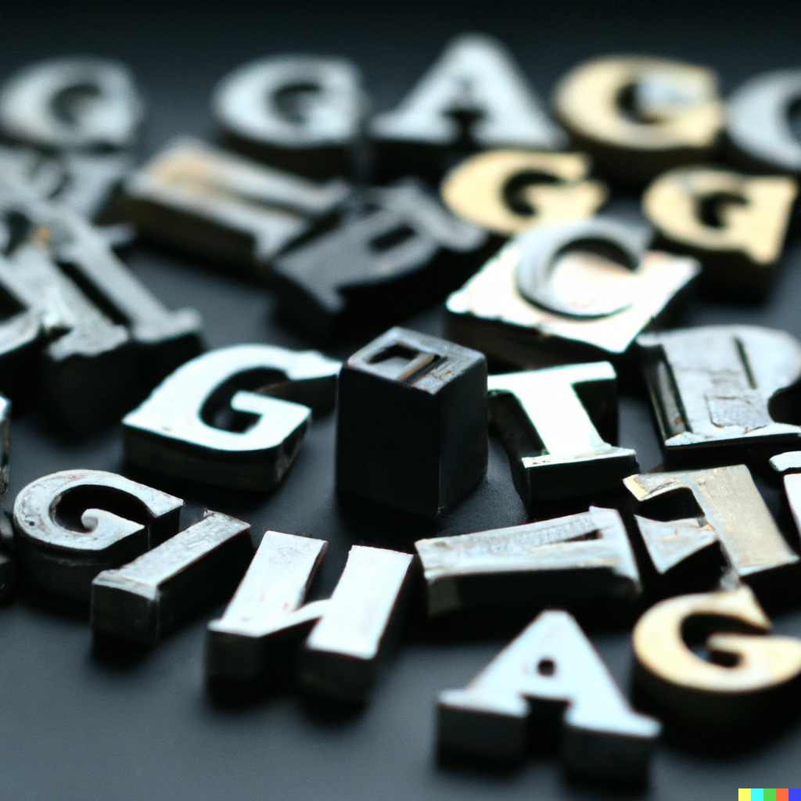
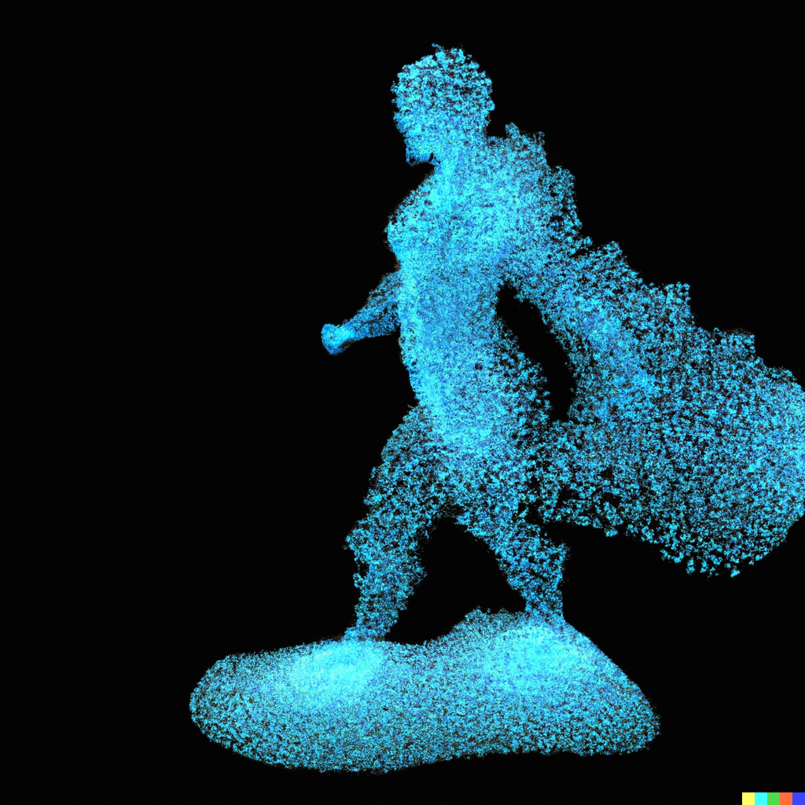
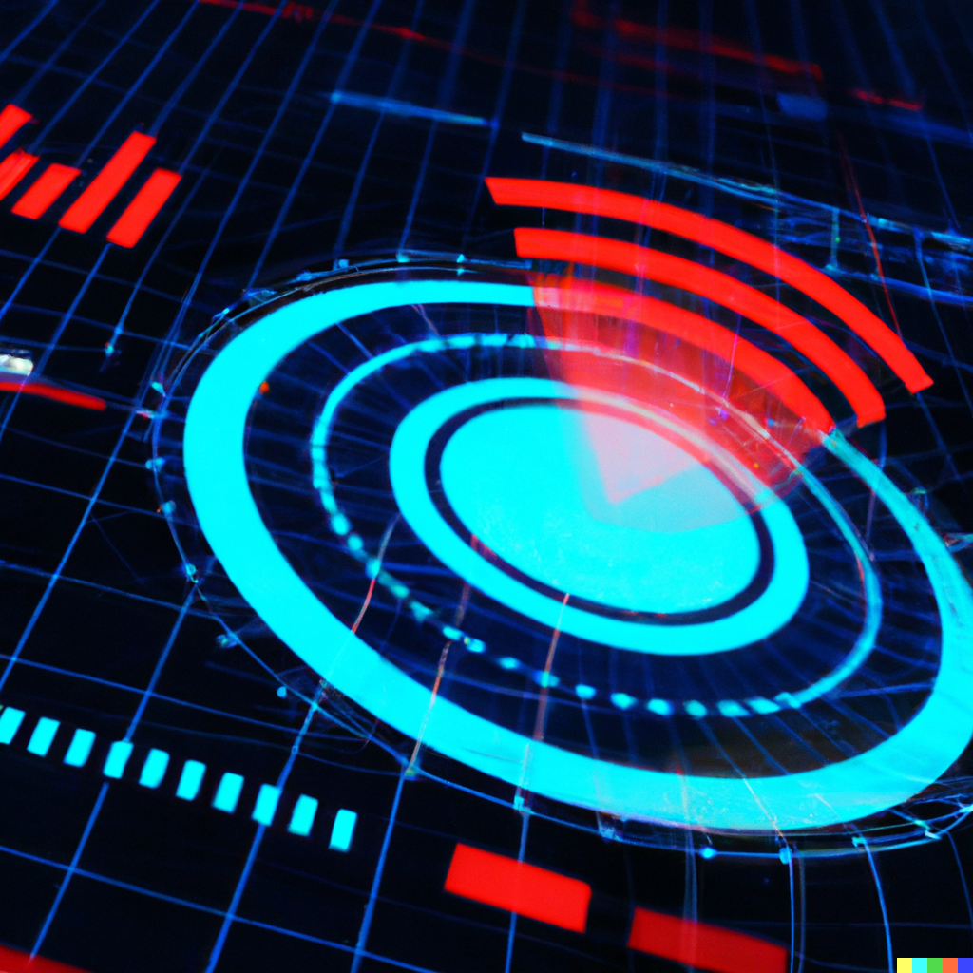


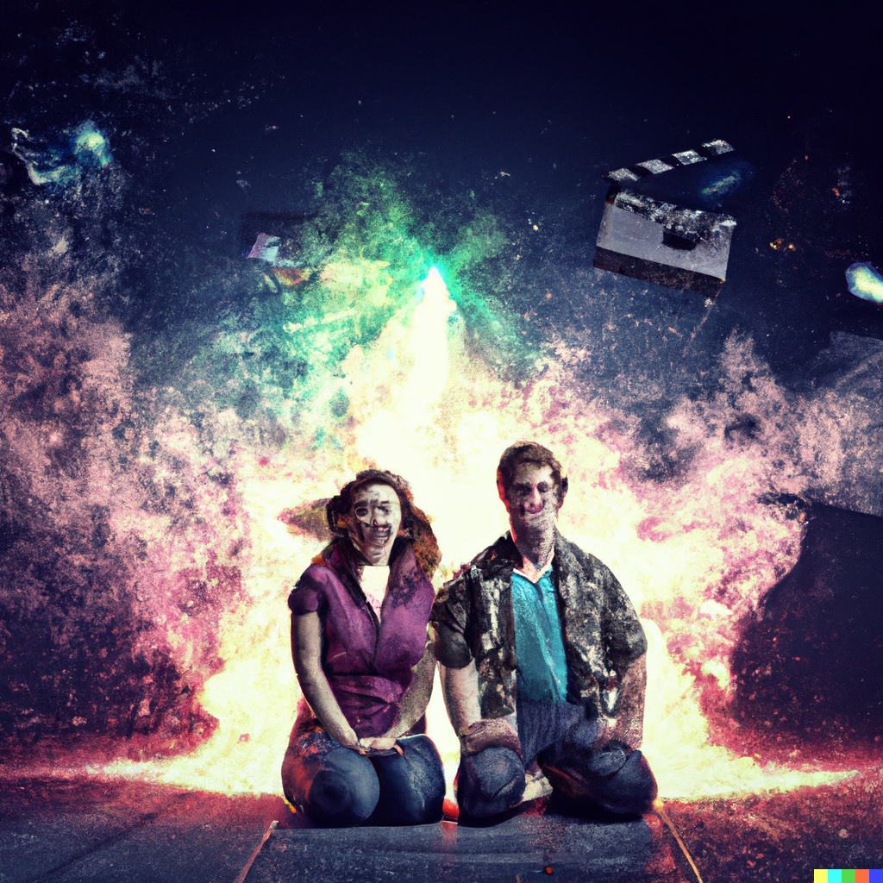
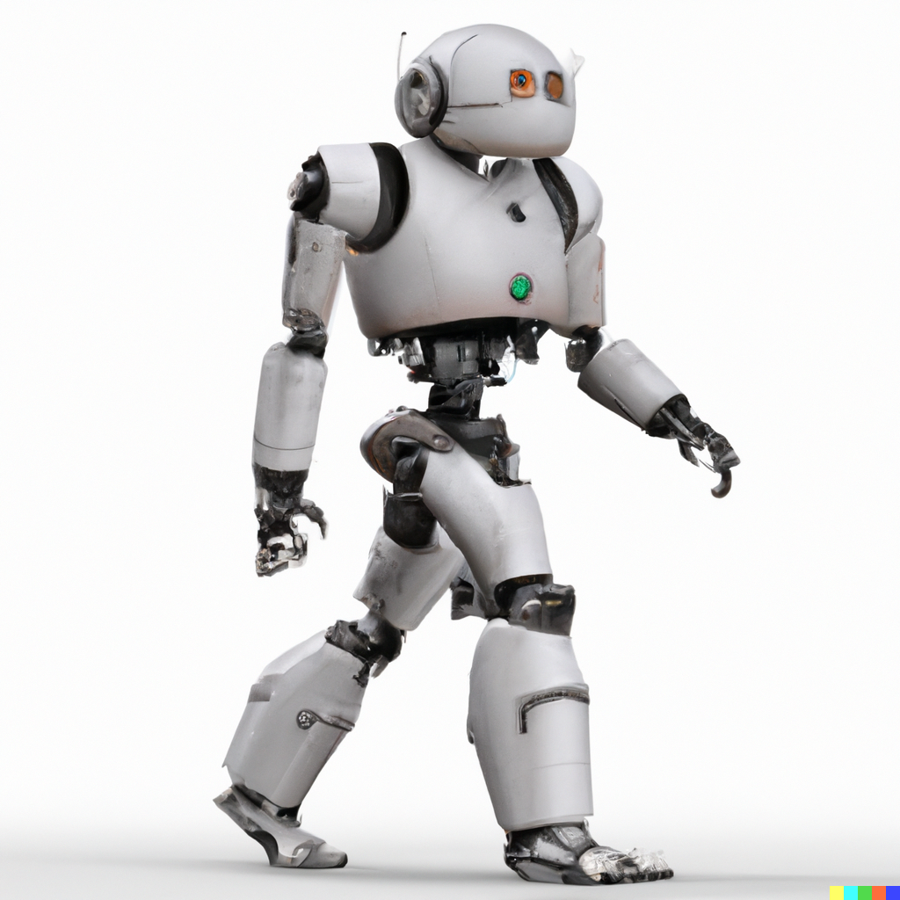
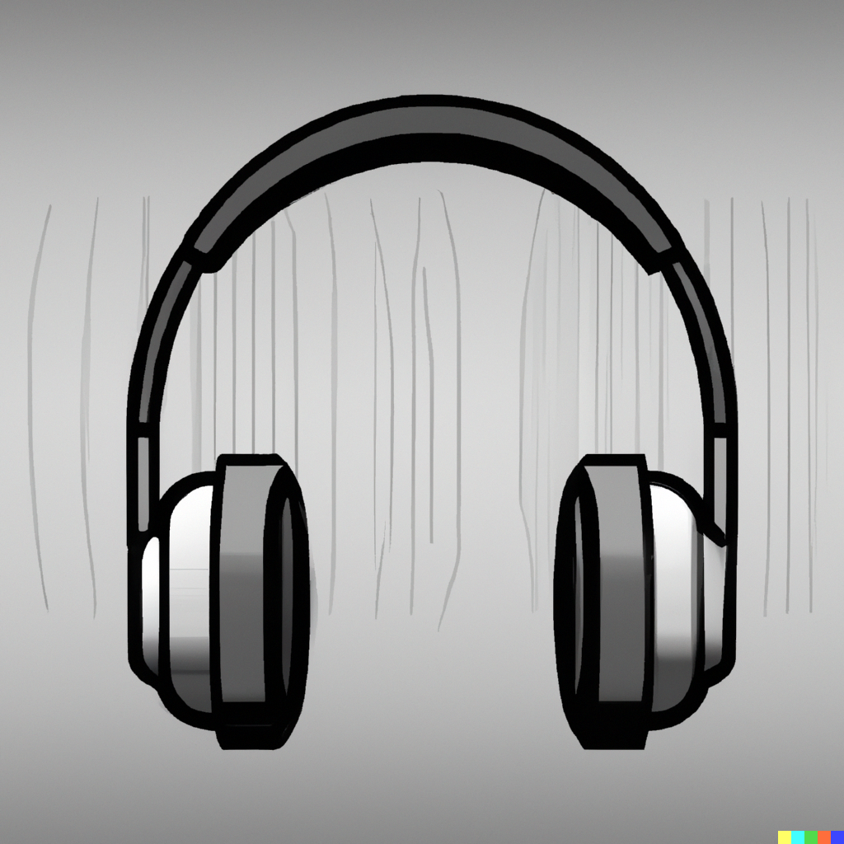
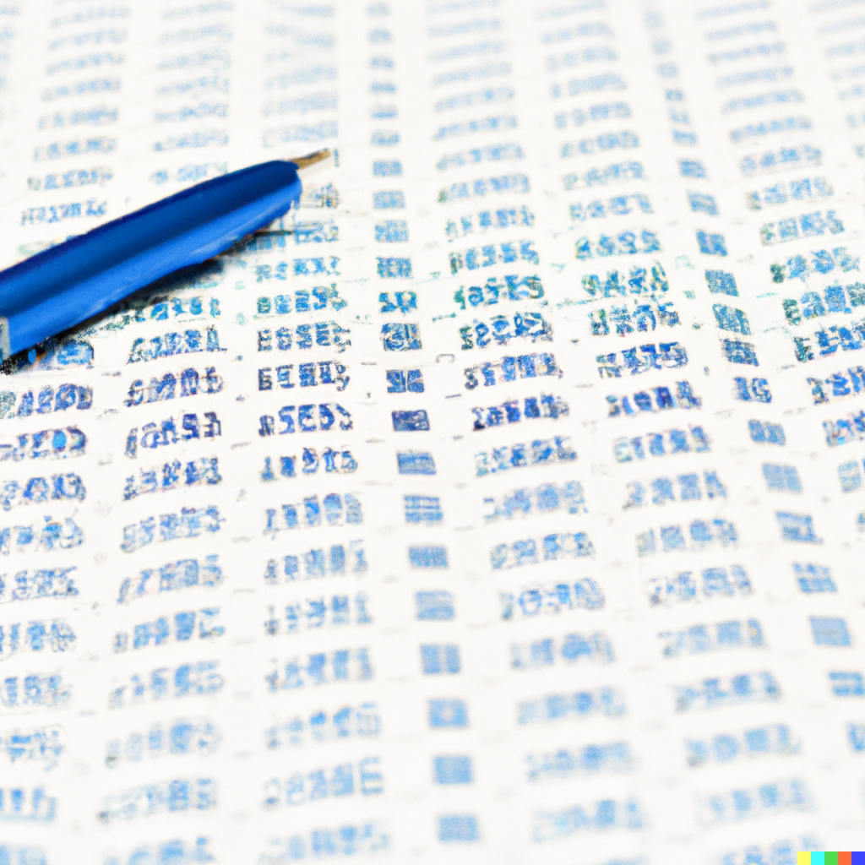
What does multimodal mean
Short answer: a model that combines multiple modalities such as
  Text
  Images
  Videos
  Audio
  Point clouds
  Haptics
  Motion
  Tabular data
  Sensor data
  …

Slide 5
What does multimodal mean
Long answer: https://www.youtube.com/playlist?list=PLki3HkfgNEsKPcpj5Vv2P98SRAT9wxIDa
“Multimodal is the science of heterogeneous and interconnected data”

Slide 6
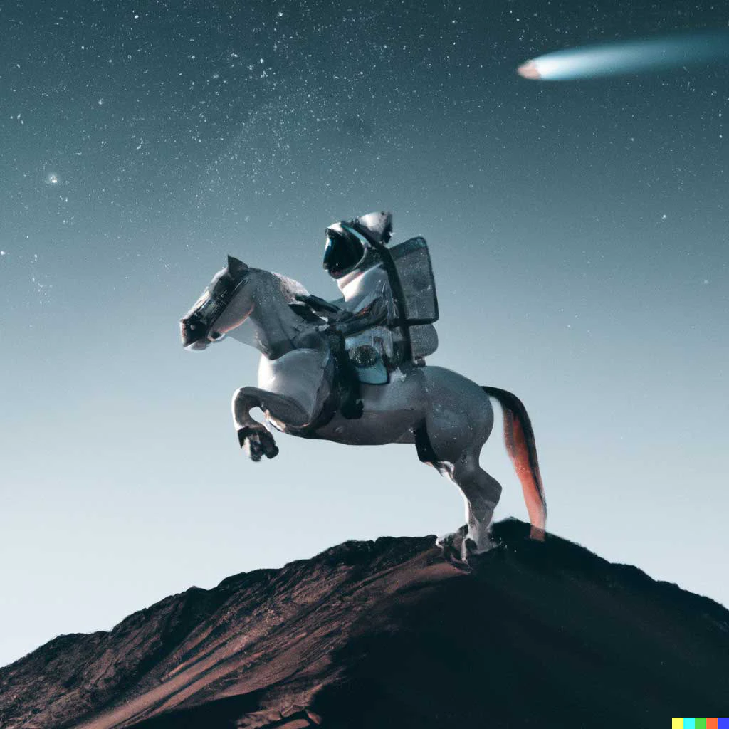
What does multimodal mean
Real-world answer (as of Apr 2023): text + images

Slide 7
What multimodal systems did you interact with before 2021?

Slide 8
(Incomplete) Recent History of Multimodal DL
BLIP,
DALL-E 2,
Latent Diffusion,
Flamingo,
CoCa,
GIT,
SayCan
2022
Models
LXMERT,
ViLBERT,
VisualBERT,
UNITER
2019
Bidirectional
Image Sentence Mapping
2015
CLIP,
DALL-E,
Frozen
2021
Show and Tell,
Wavenet
2016
StyleGAN
2018
OSCAR
2020
PALM-E
2023

Slide 9
(Incomplete) Recent History of Multimodal DL
BLIP,
DALL-E 2,
Latent Diffusion,
Flamingo,
CoCa,
GIT,
SayCan
2022
Models
LXMERT,
ViLBERT,
VisualBERT,
UNITER
2019
Bidirectional
Image Sentence Mapping
2015
CLIP,
DALL-E,
Frozen
2021
Show and Tell,
Wavenet
2016
StyleGAN
2018
OSCAR
2020
PALM-E
2023
Classical DL era
BERT era
Language models,
Diffusion models

Slide 10
(Incomplete) Recent History of Multimodal DL
BLIP,
DALL-E 2,
Latent Diffusion,
Flamingo,
CoCa,
GIT,
SayCan,
Imagen Video
2022
Models
LXMERT,
ViLBERT,
VisualBERT,
UNITER
2019
Bidirectional
Image Sentence Mapping
2015
CLIP,
DALL-E,
Frozen
2021
Show and Tell,
Wavenet
2016
PALM-E
GPT4
2023
StyleGAN
2018
OSCAR
2020
Image
search
Image captioning,
Text2speech
Image generation,
Style Transfer
VQA,
VNLI
Image search,
Text2Image,
Impainting,
VQA,
Visual Dialogue
Robotic control,
Text2video
Tasks

Slide 11
Classical DL era

Slide 12
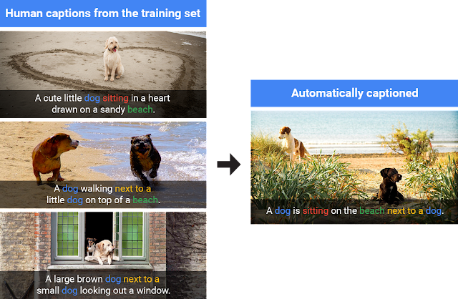
Image captioning

Slide 13
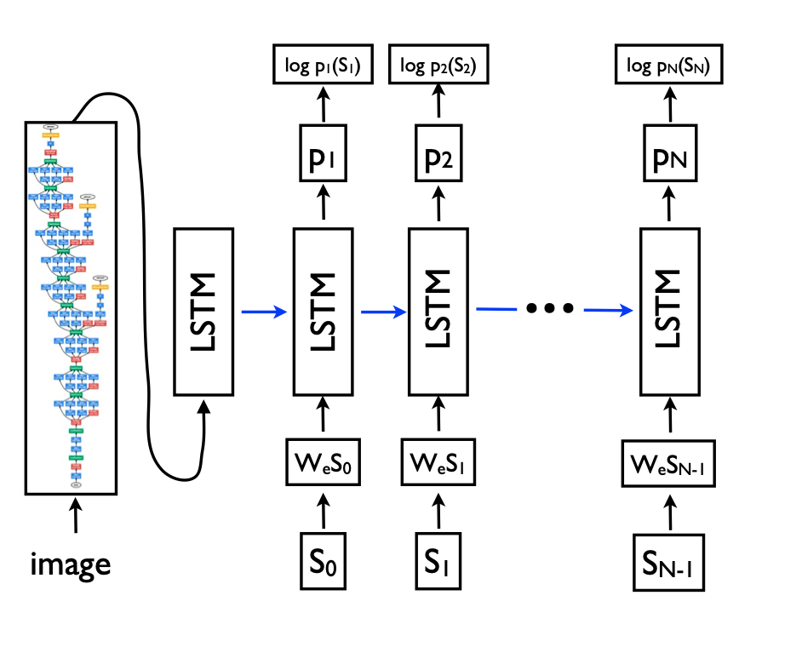
Image captioning

Slide 14
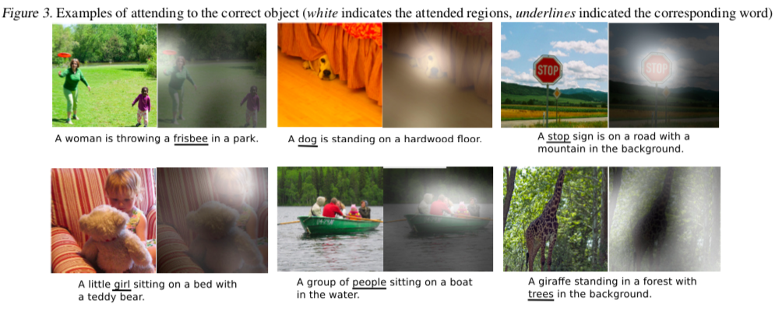

Slide 15
BERT Era

Slide 16
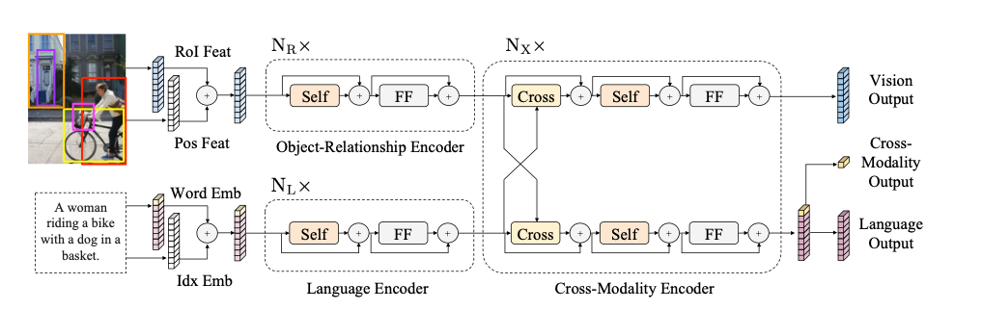
LXMERT

Slide 17
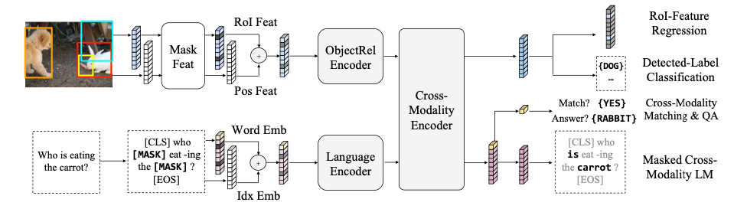

Slide 18
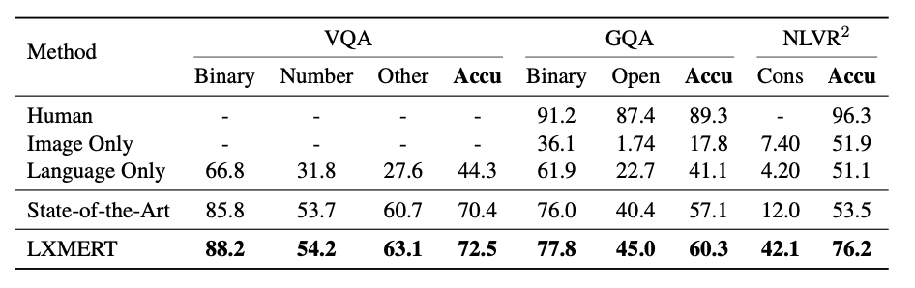

Slide 19
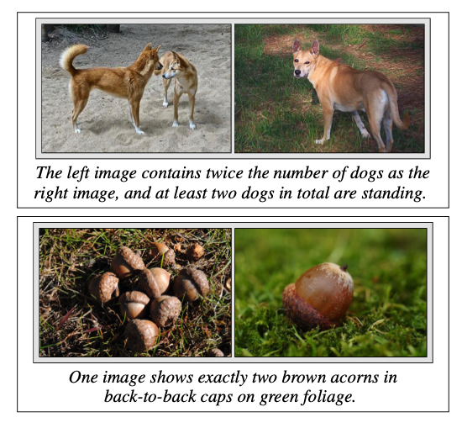
NLVR2

Slide 20
CLIP

Slide 21
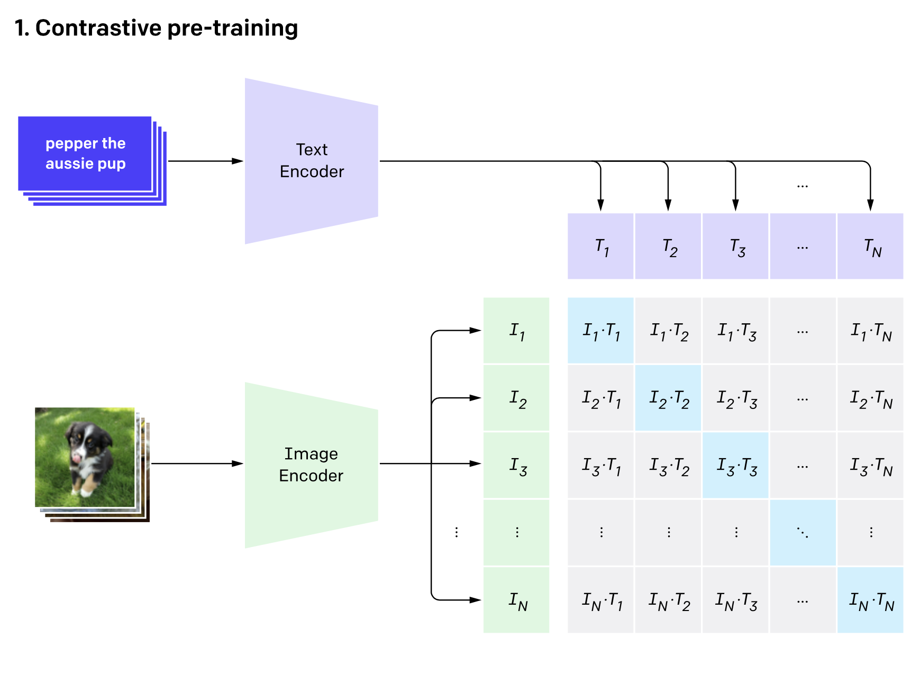
CLIP

Slide 22
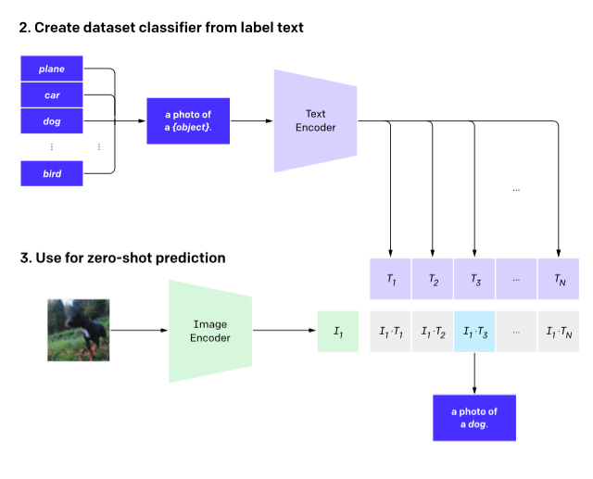
CLIP

Slide 23
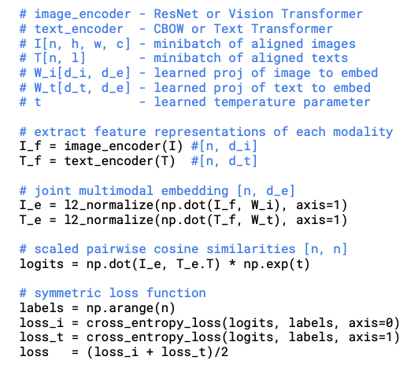
CLIP

Slide 24
Text2image

Slide 25
DALL-E
Autoregressive image generation

Slide 26
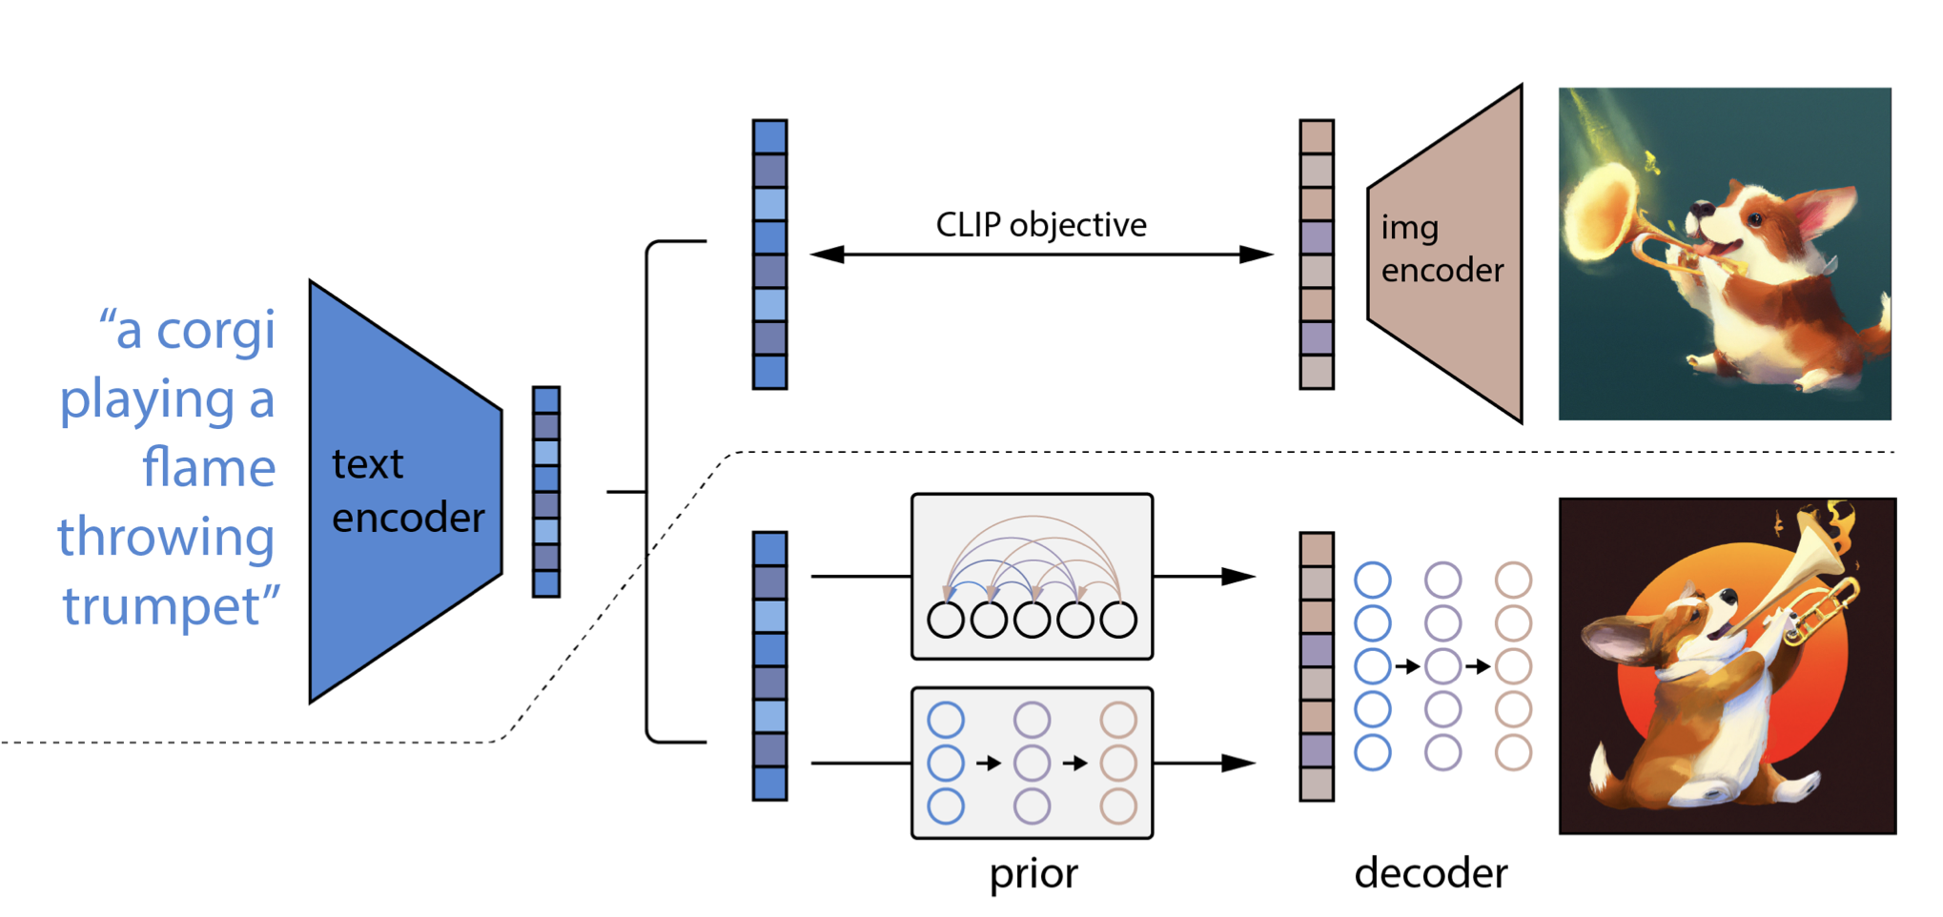
DALL-E 2
Diffusion Models

Slide 27
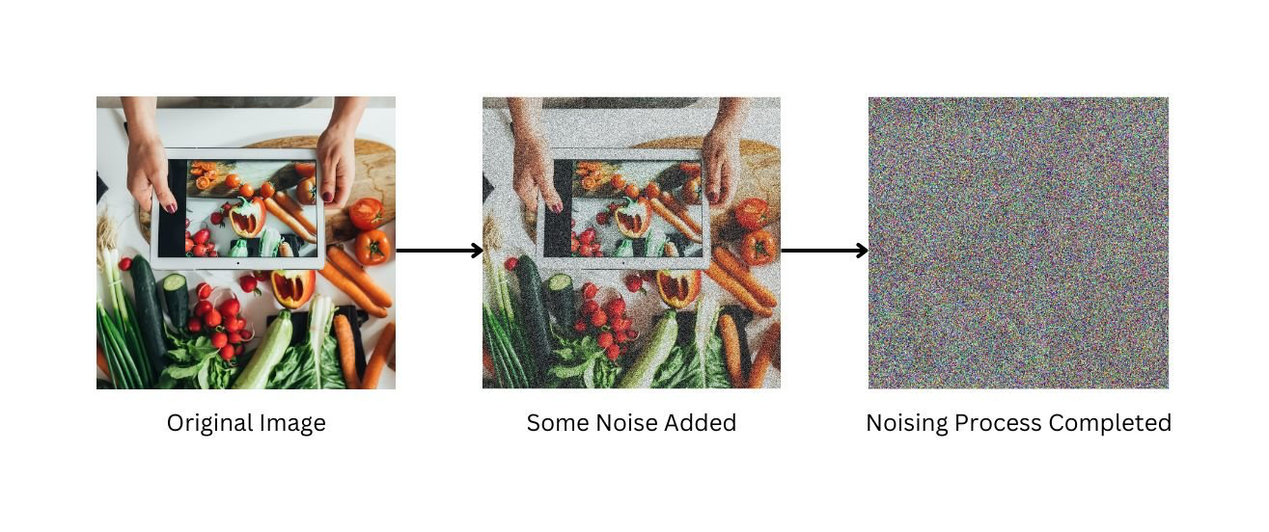
Diffusion models
https://scale.com/guides/diffusion-models-guide#what-are-diffusion-models?

Slide 28
Vision Transformer
(ViT)

Slide 29
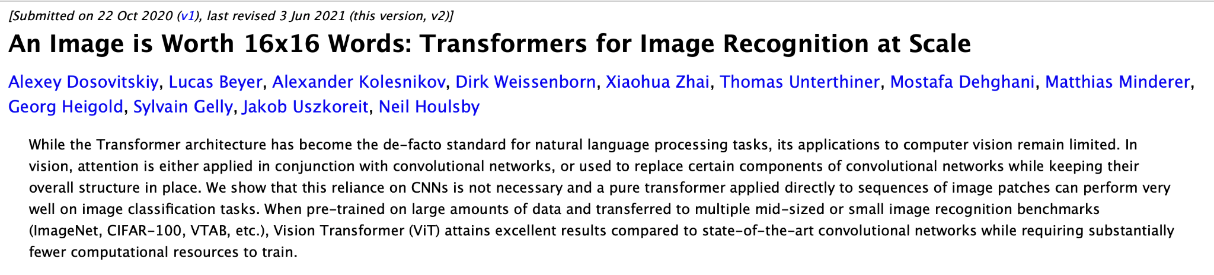
Vision Transformer

Slide 30
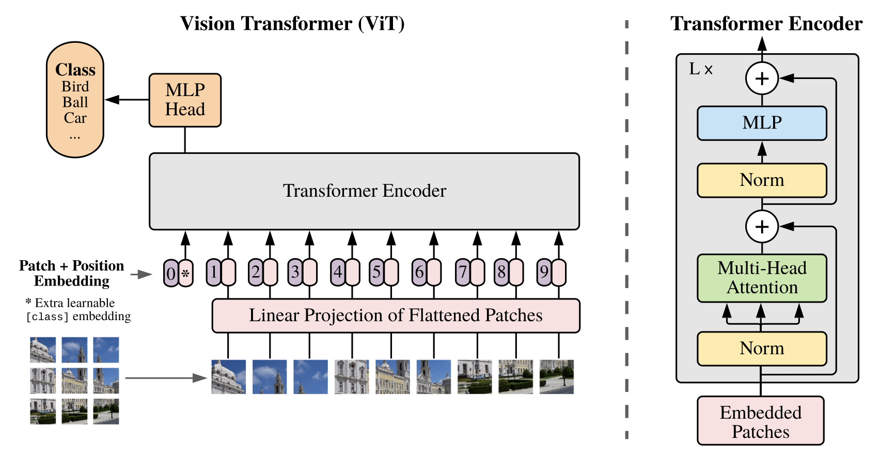
Vision Transformer

Slide 31
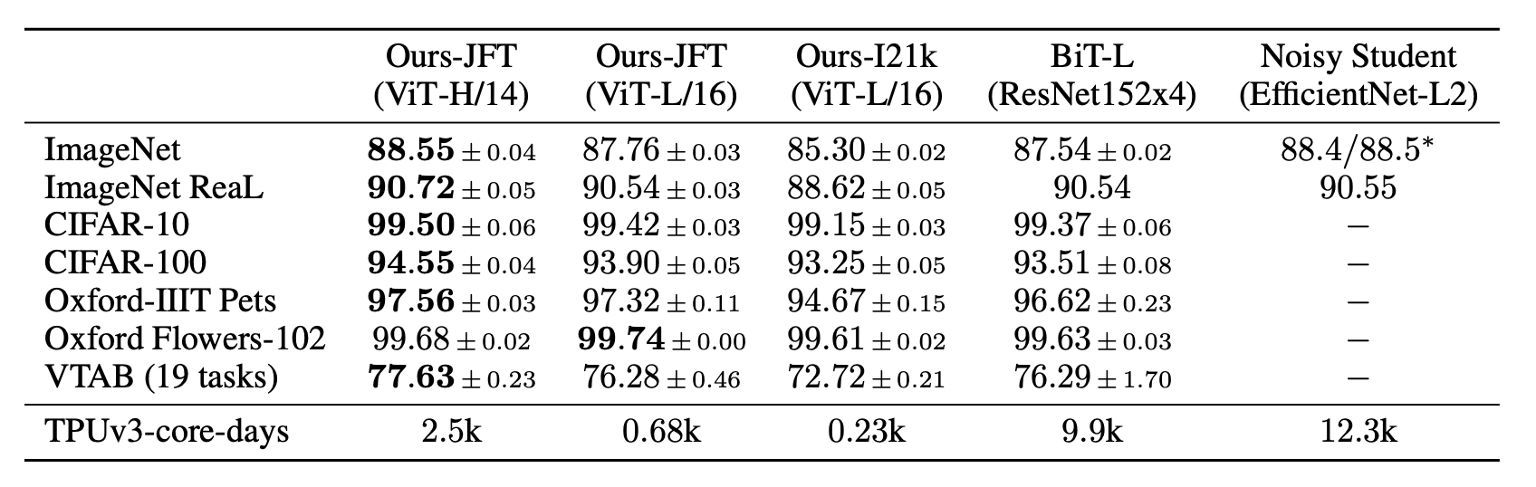
Vision Transformer
Fewer computational resources to train than CNNs

Slide 32
Multimodal language models

Slide 33
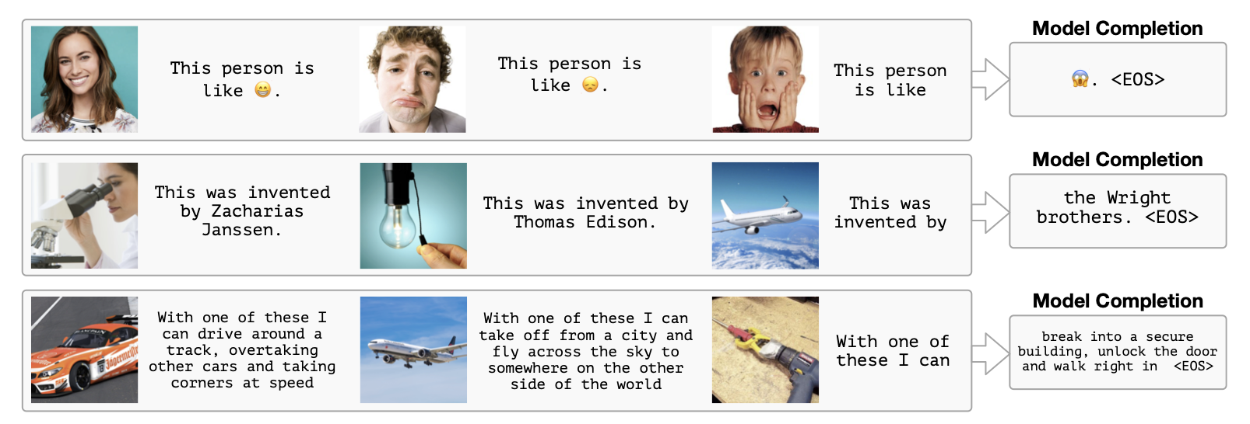
2021: Frozen

Slide 34
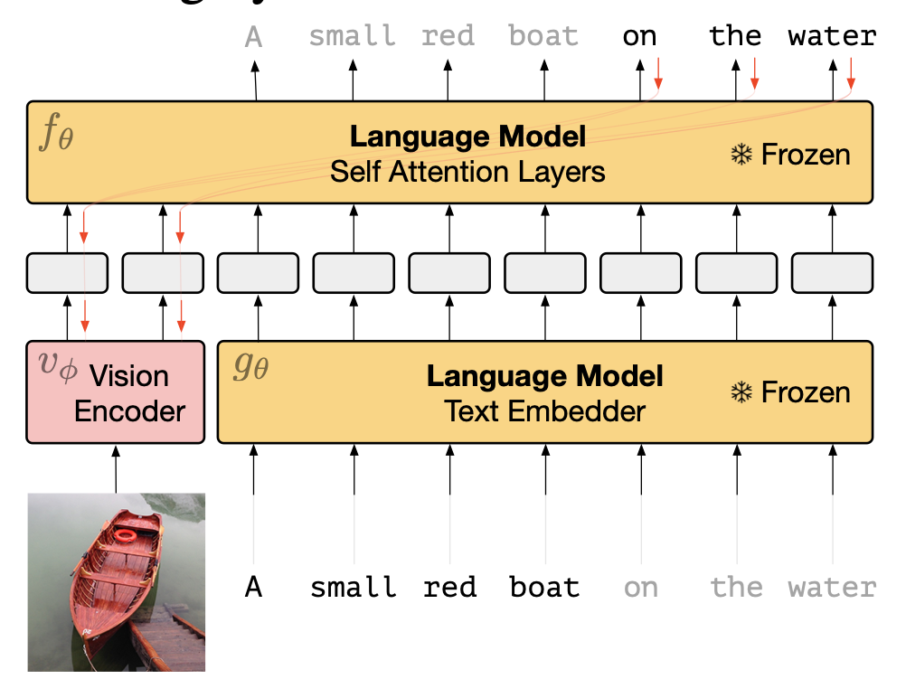
2021: Frozen

Slide 35
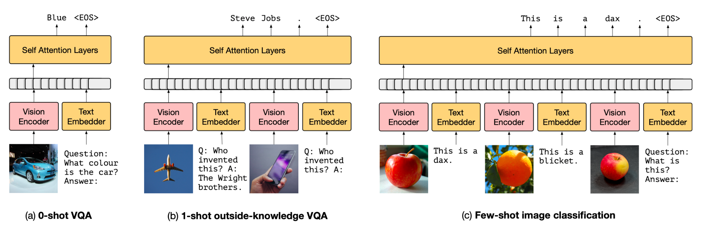
2021: Frozen

Slide 36
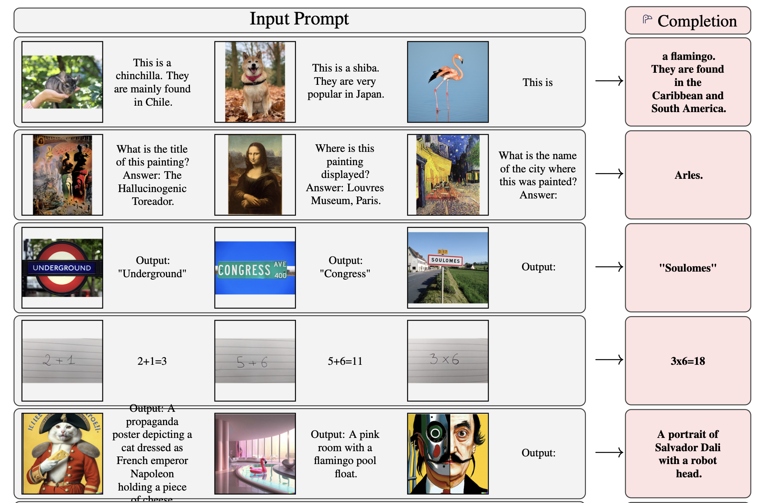
2022: Flamingo

Slide 37
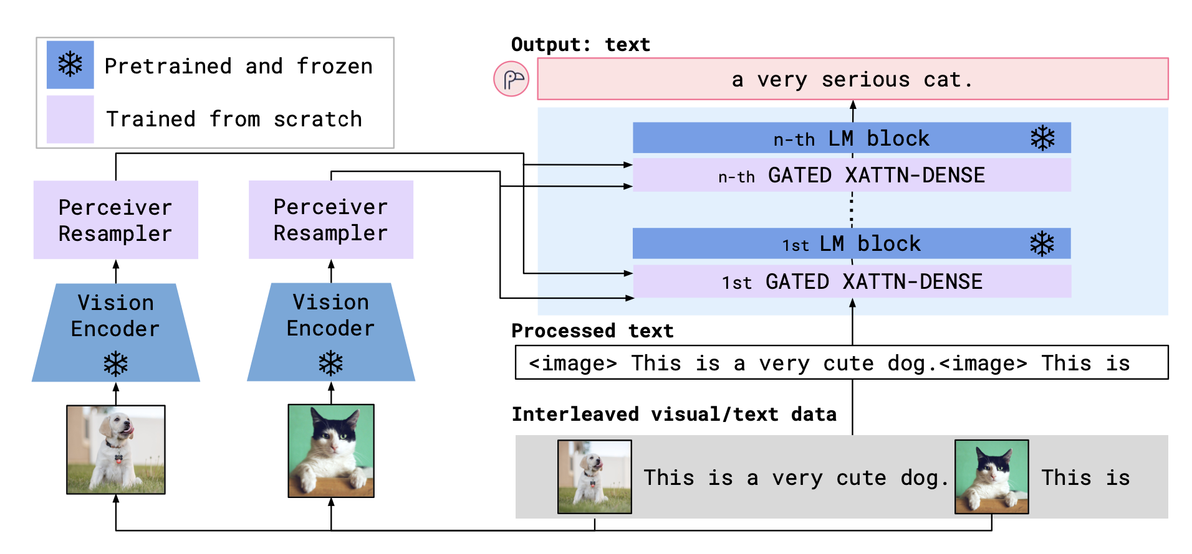
2022: Flamingo

Slide 38
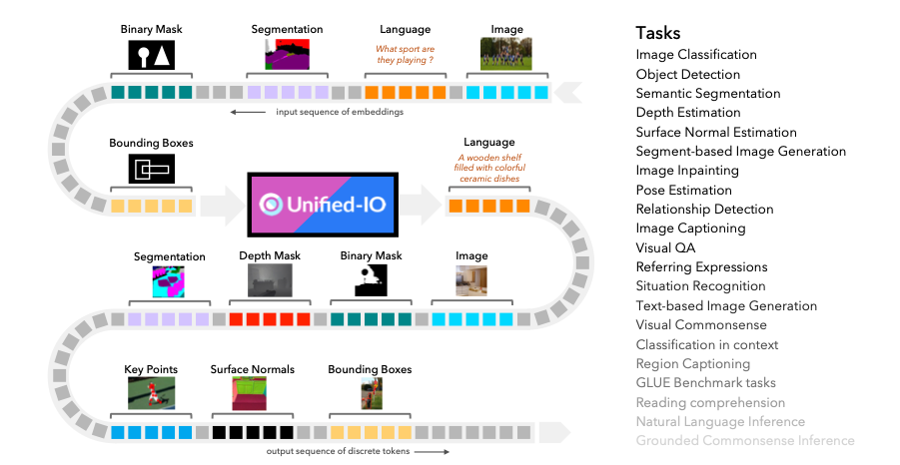
Unified-IO: anything-input anything-output for text and vision

Slide 39
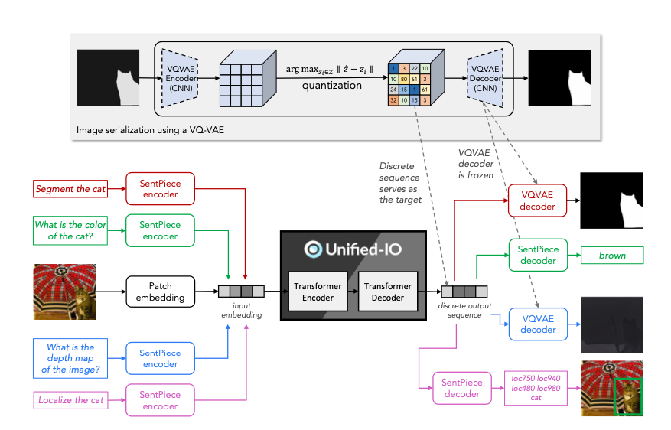
Unified-IO: anything-input anything-output for text and vision

